Slide 1
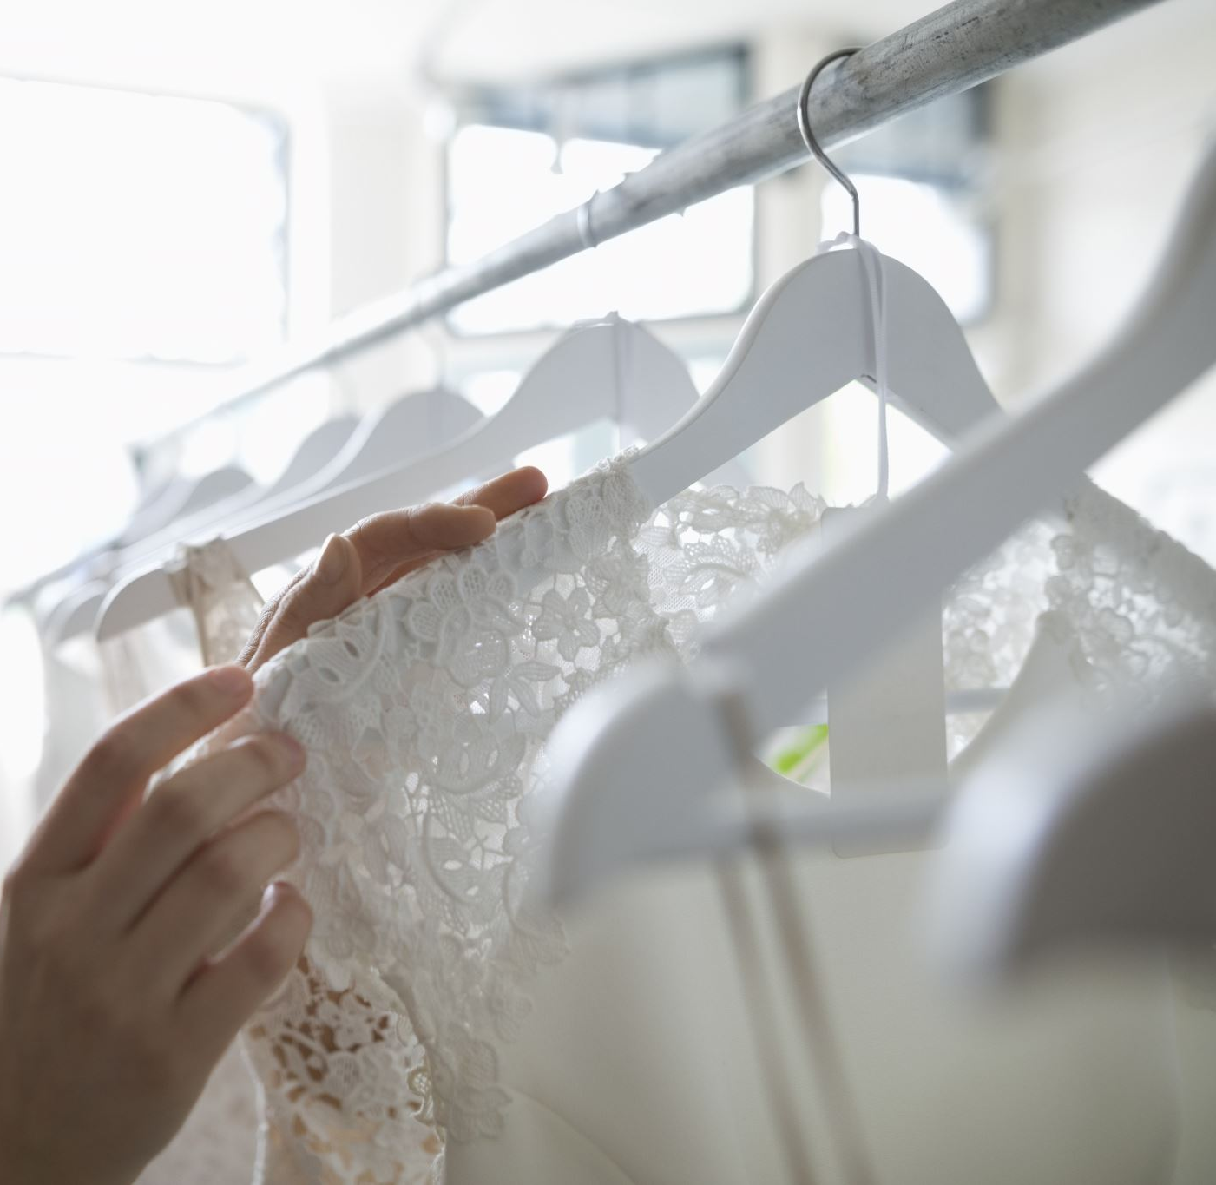
Clothing Data Exploration
Herminnia Flores (Jessica)
JoHanna Nelson (Joey)
Carrie Buckwater
Christina Simbenga
Woz U

Slide 2
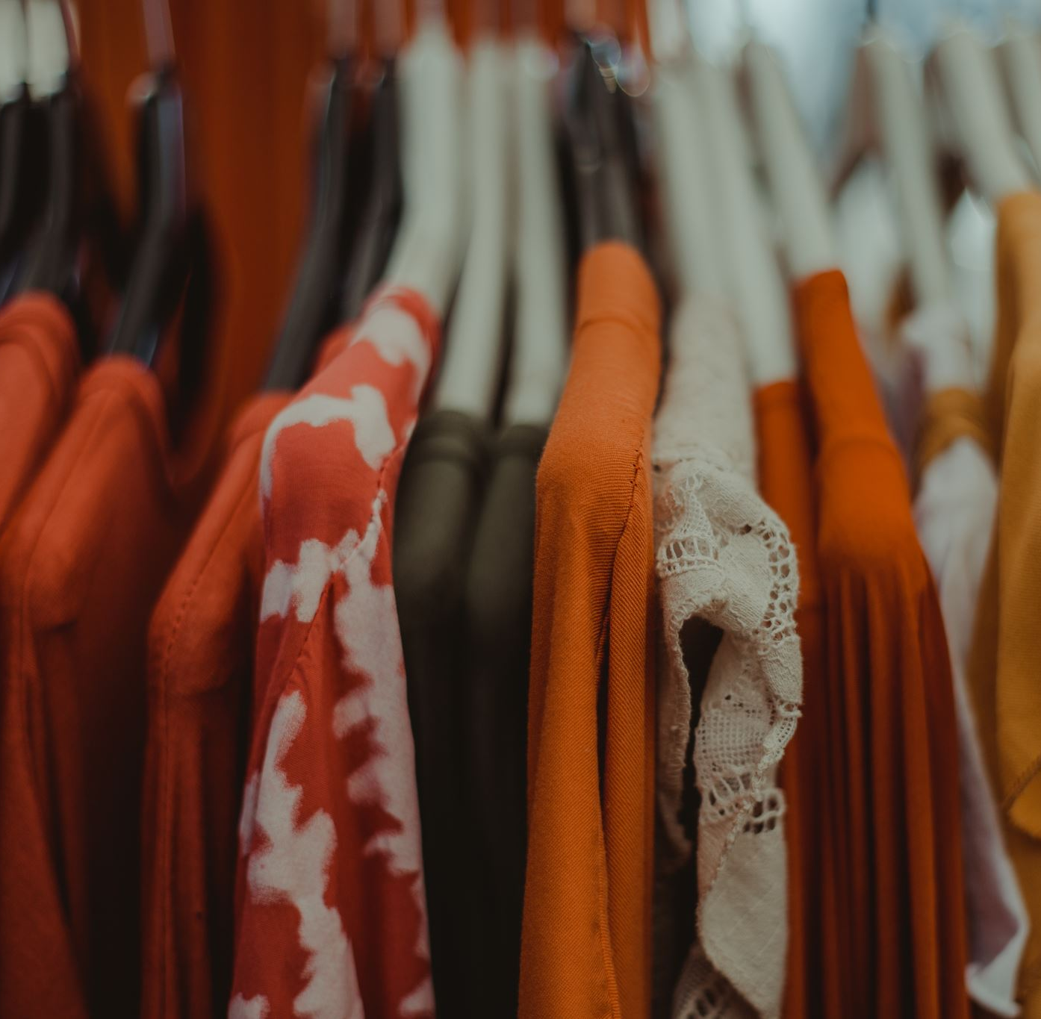
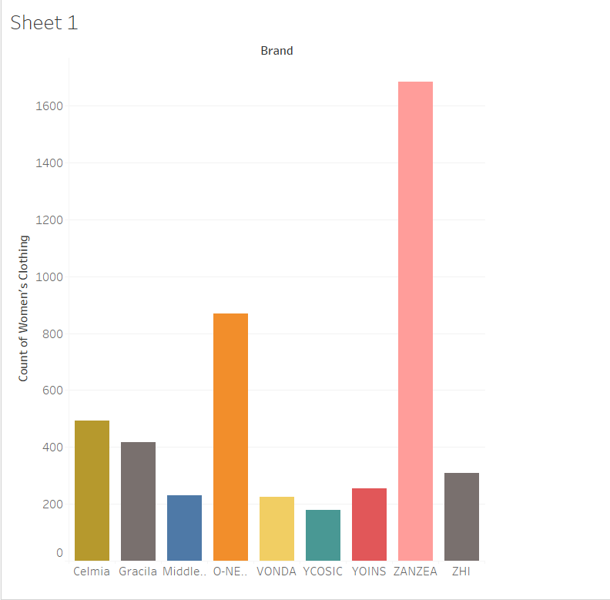
Clothing Brand
Below is a bar chart consisting of amounts over 100 , for womens purchases, by brand.

Slide 3
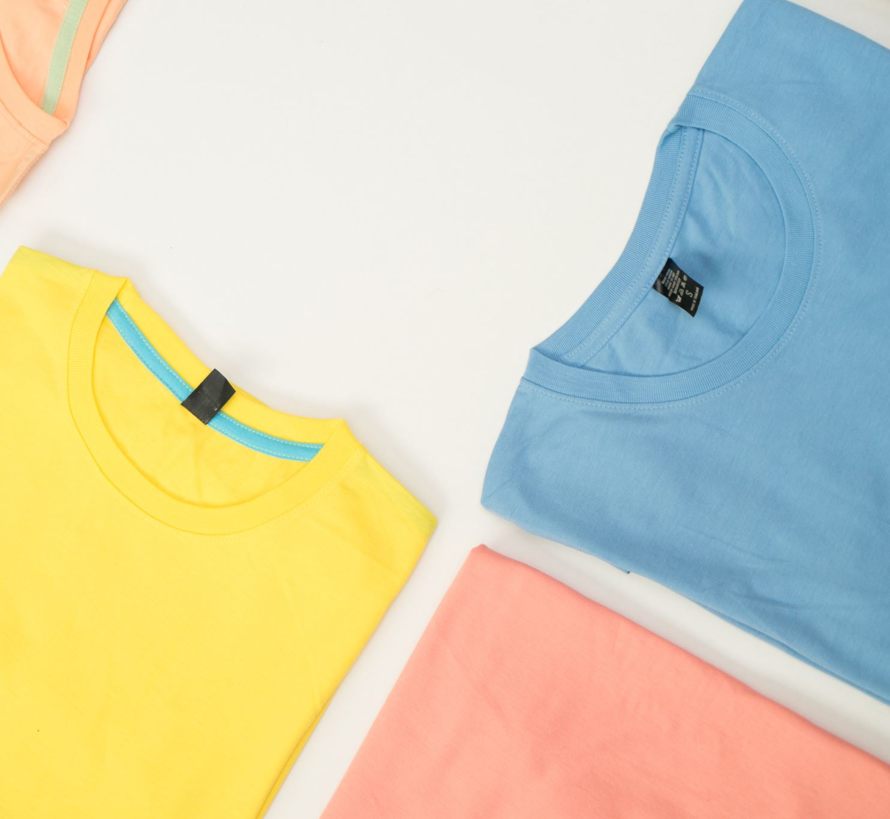
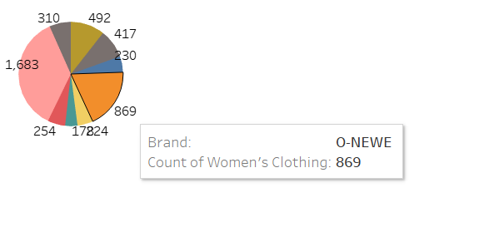
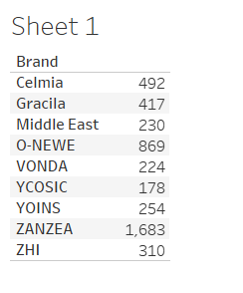
Clothing Brand
A Pie chart consisting of 9 brands with amounts of over 100 for purchases by women.

Slide 4
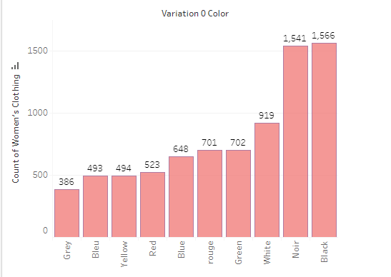
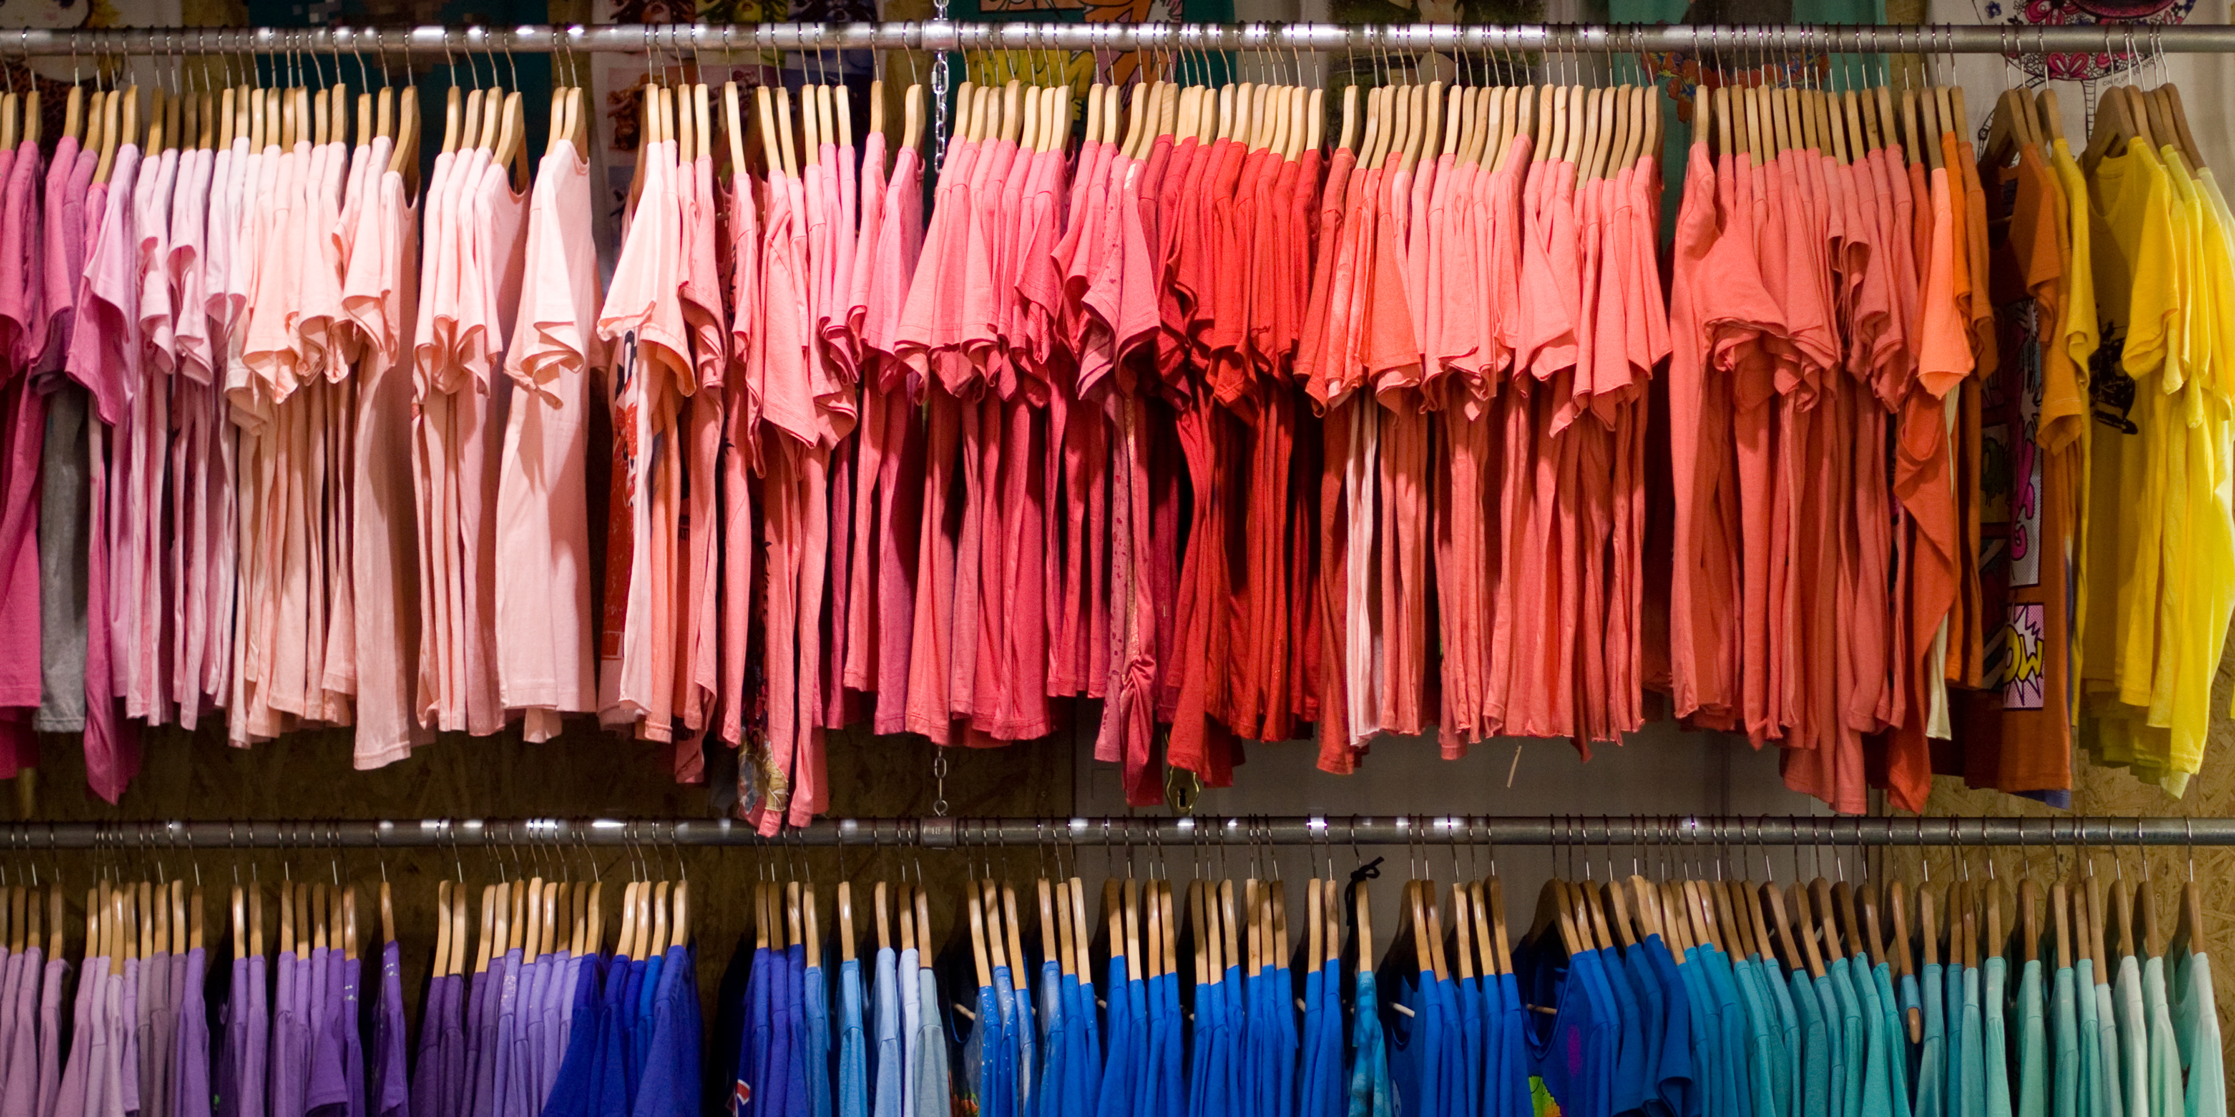
Clothing by Color
Bar Chart Consisting of top 10 colors women purchase most with amounts of over 100

Slide 5
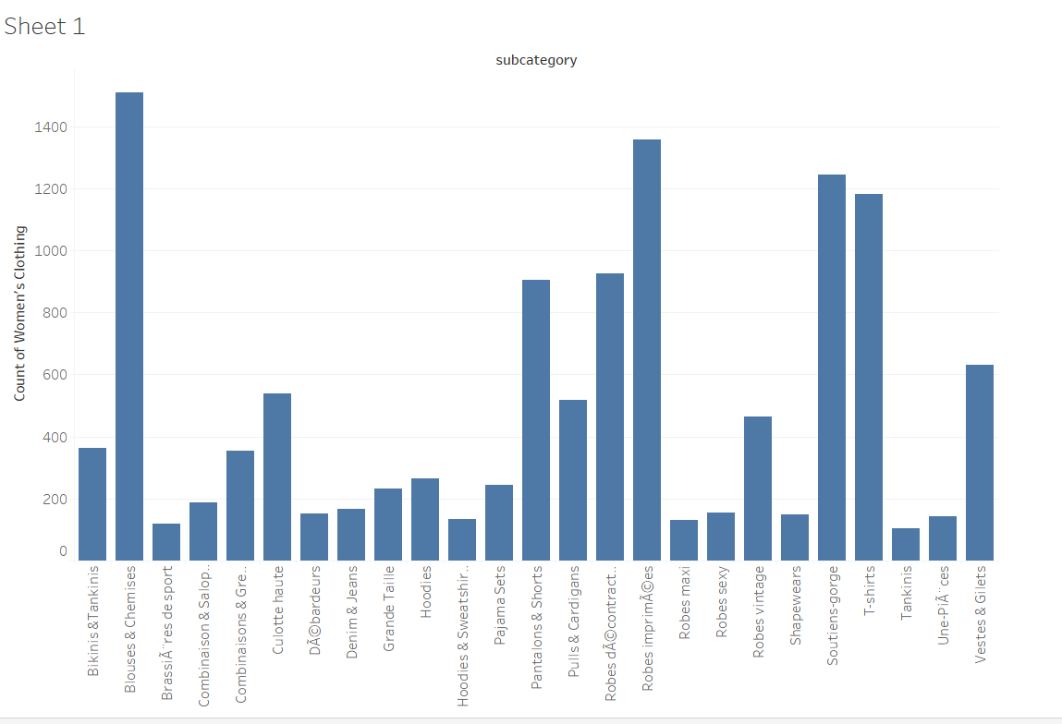
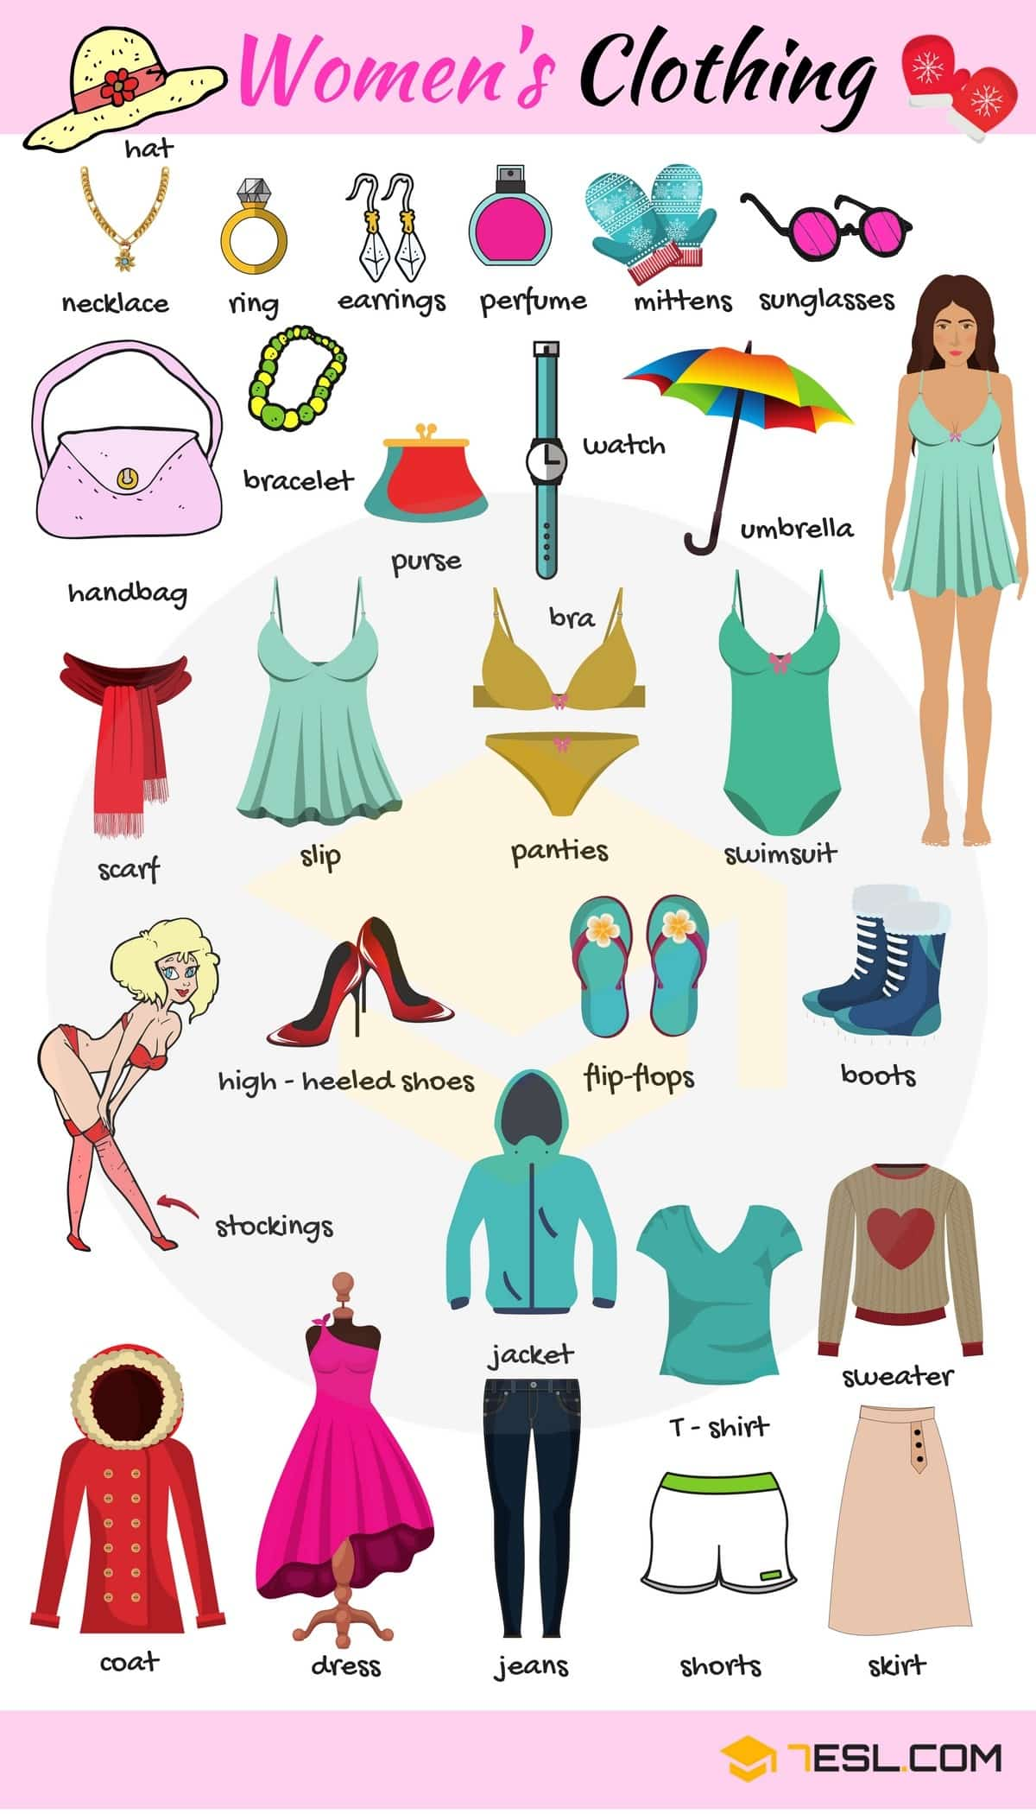
Types of Clothing
Types of clothing articles purchased by women , with amounts of over 100.

Slide 6
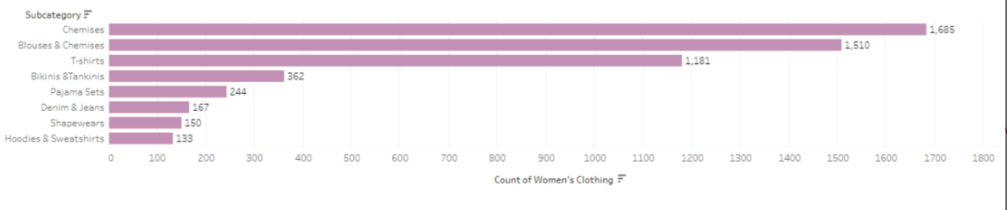
Most Common Types of Women’s Clothing Eliminating anything 1 – 100 descending

Slide 7
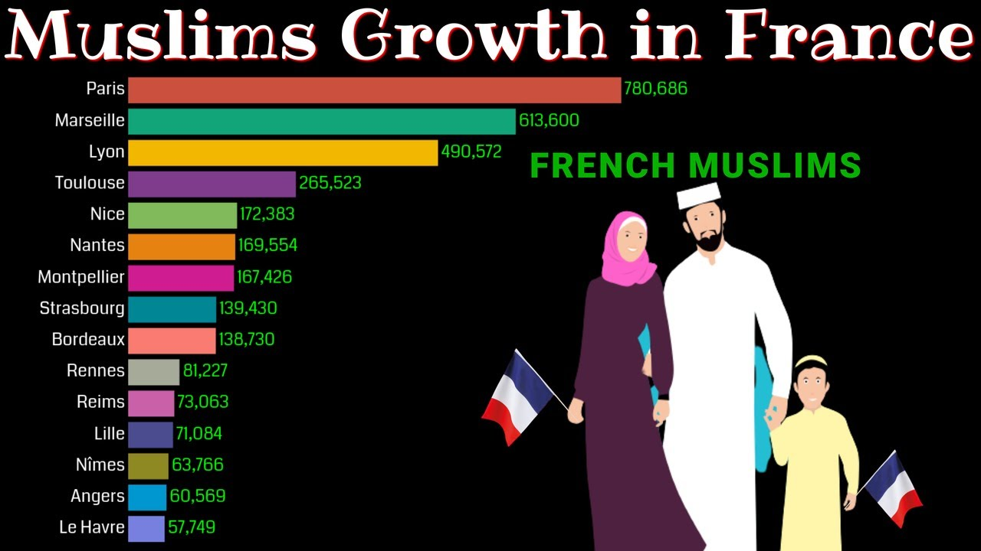
Population Served
As we went along with our data exploration we looked up these brands
We found these brands are based out of France and include a large Muslim clientele
Because of the Muslim clientele the clothing is more conservative as well as the clothing is more affordable than typical French fashion
We do not have a ton of data on things like shorts and bikinis because those are purchased less by the Muslim clientele

Slide 8
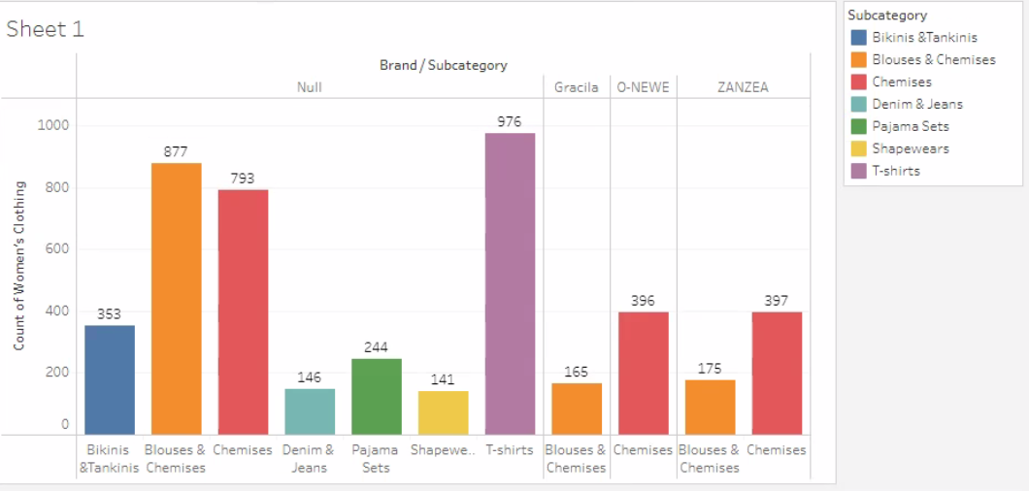
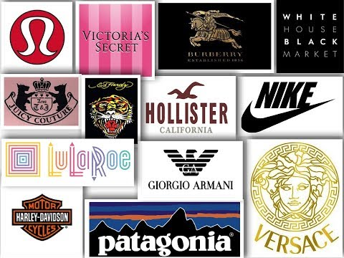
Clothing Type Broken Down By Brand Including Null
A lot of the data available for clothing type plus brand included null
Many of the brands did not report data broken down by clothing type
This slide represents the data available including null anything above 100

Slide 9
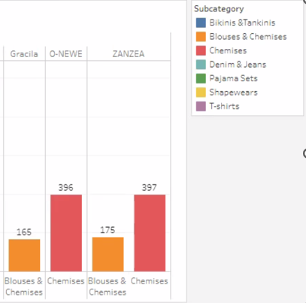
Clothing Type Broken Down By Brand Excluding Null
This slide represents the brands that reported data of clothing type plus brand anything from 100 or above
As you can see from this slide only a few brands reported their most purchased clothing types

Slide 10
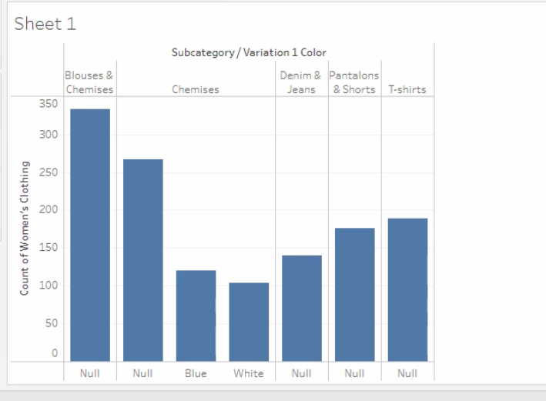
Clothing type tops and bottoms and Color Including Null anything above 100
Next we wanted to explore the clothing types that were categorized tops and bottoms anything above 100 counts
As you can see similarly to the previous slides a lot of data for color plus tops and bottoms simply were not reported

Slide 11

Including anything 10 – 100 to get more results and explore the data further
As our data exploration progressed we decided to include numbers 10 – 100 so we could get more results to explore
The following slides explained by Jessica and Joey will have more information about what we found as a team

Slide 12
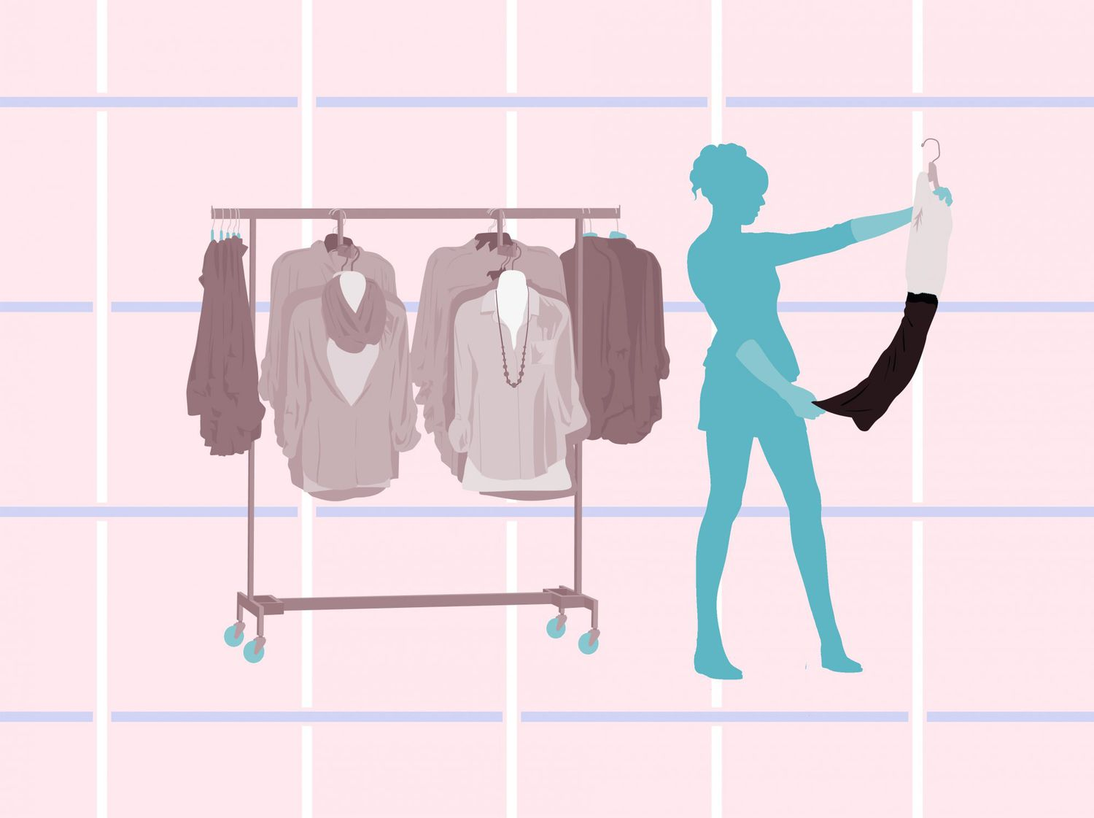
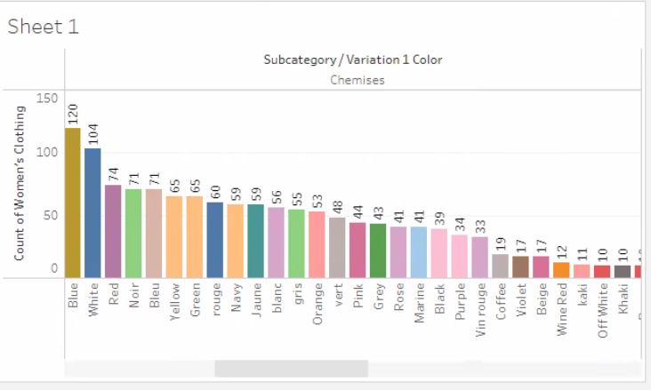
Blouses and Chemises sorted by count and color numbers 10 – 100 included

Slide 13
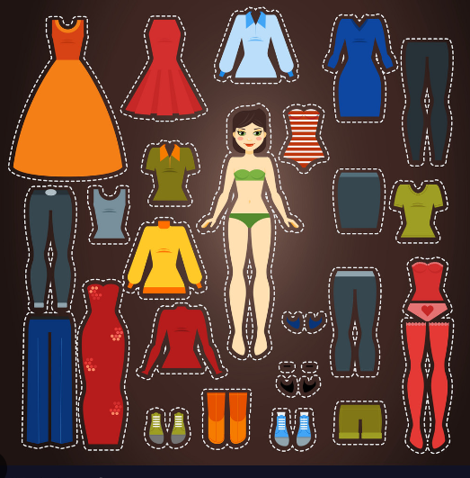
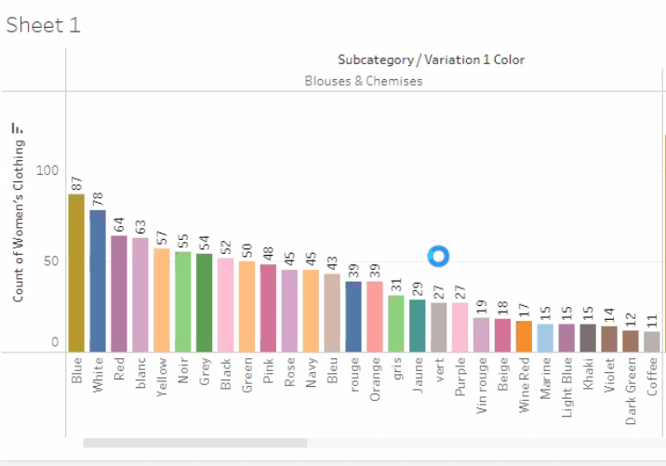
Chemises sorted by count and color numbers 10 – 100 included

Slide 14
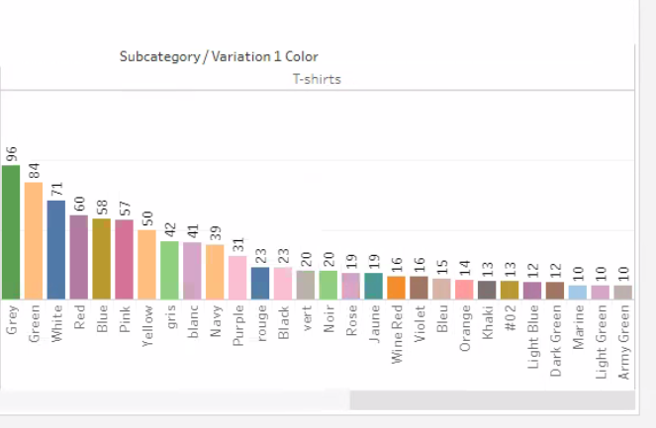
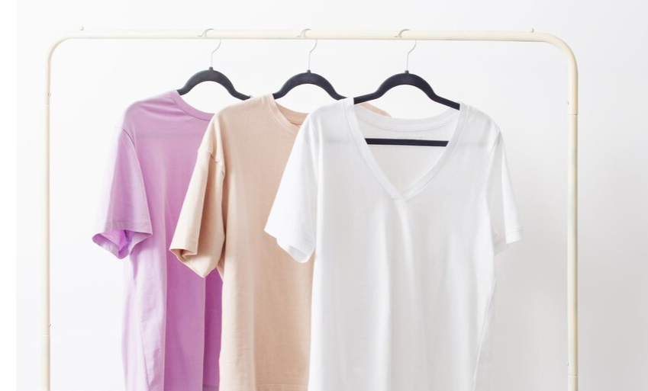
T shirts sorted by count and color numbers 10 – 100 included

Slide 15
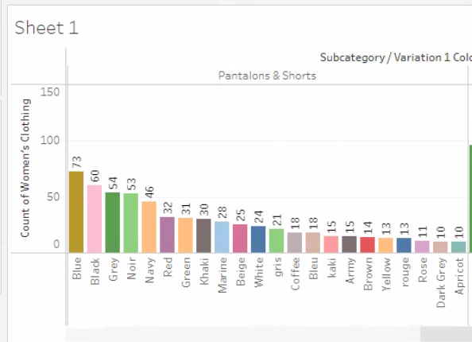
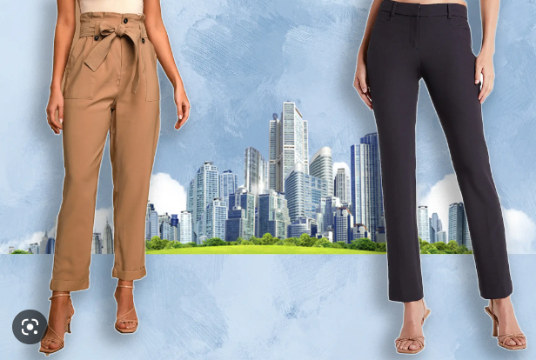
Pants and Shorts Sorted by Color numbers 10 – 100 included

Slide 16
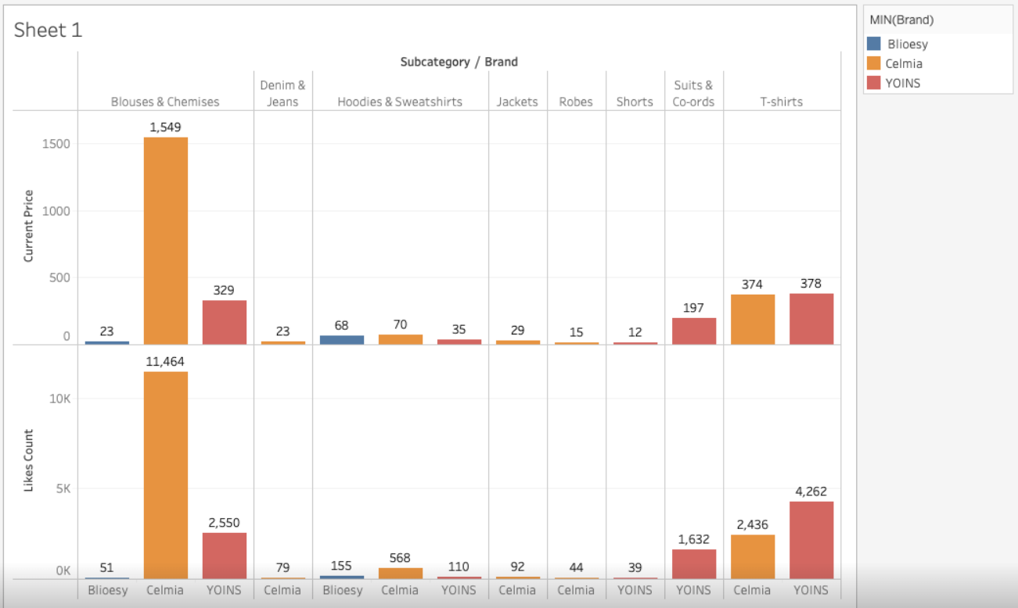
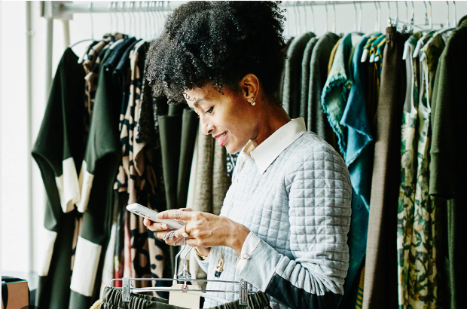
Likes By Clothing Type and Current Price Comparison

Slide 17
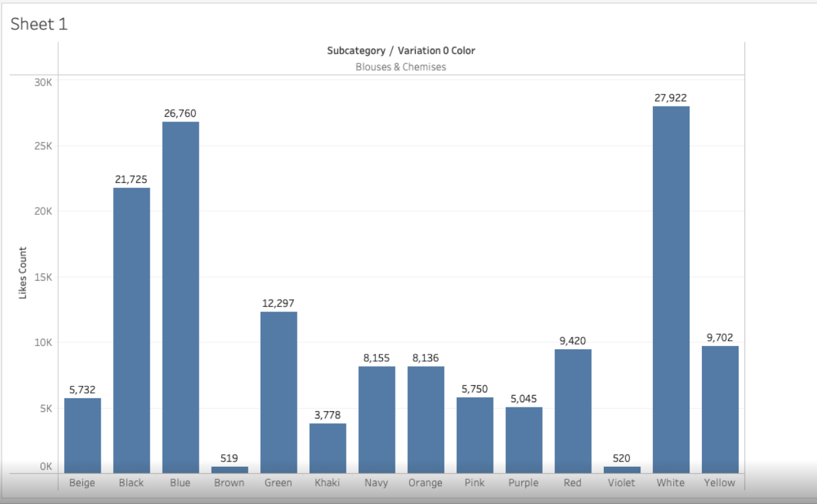
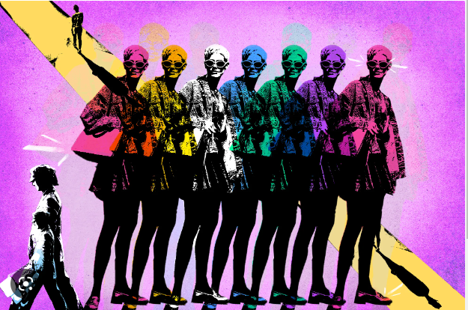
Likes By Color

Slide 18
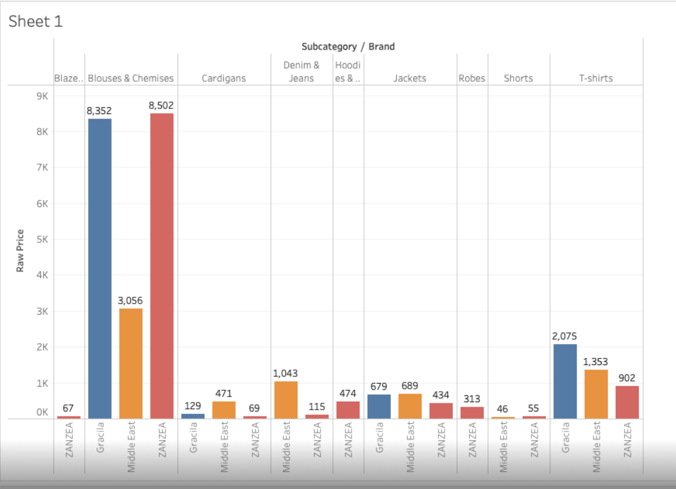
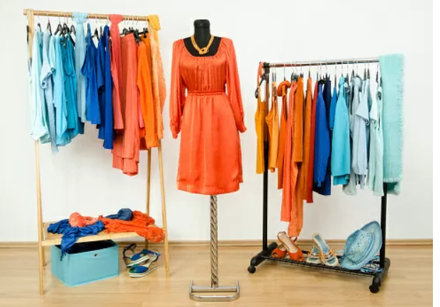
Brand and Raw Price over all Time

Slide 19
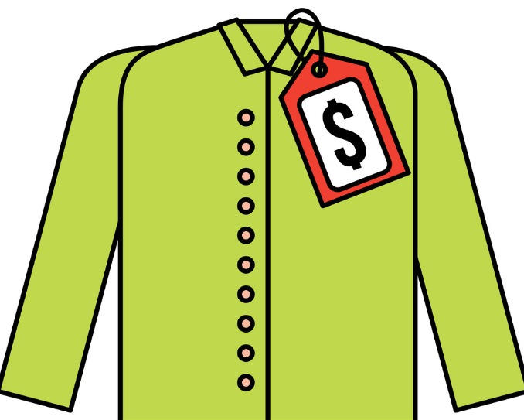
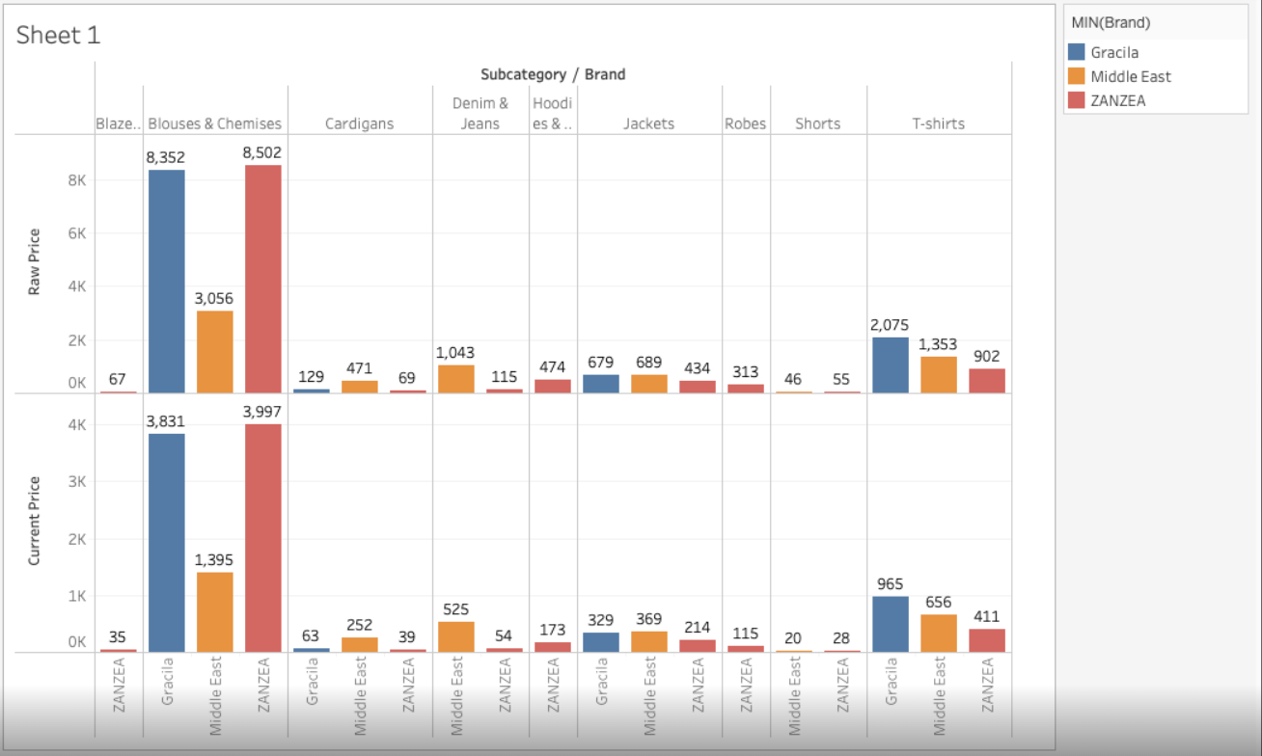
Raw Price and Brand Vs Current Price

Slide 20
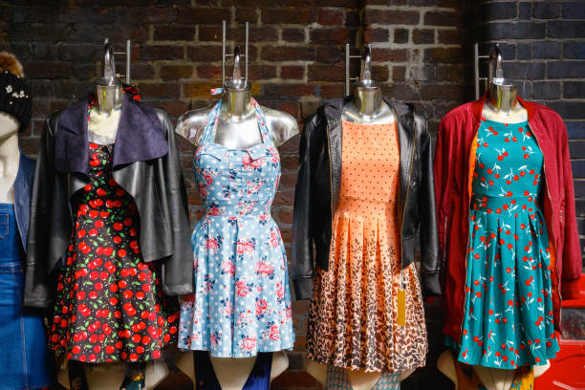
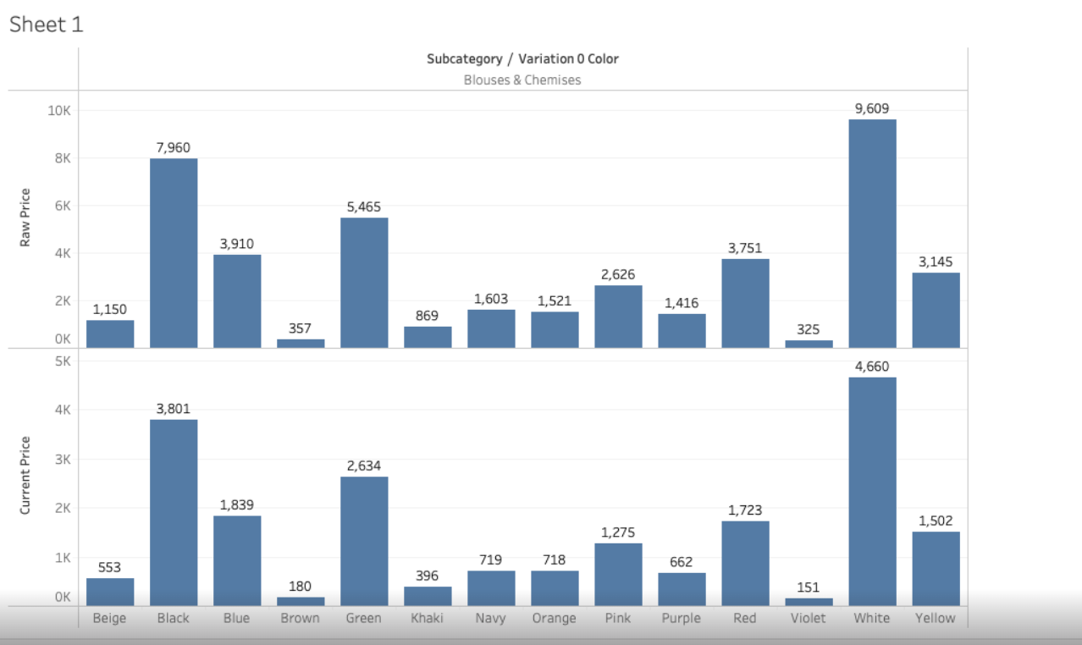
Looking at Raw Price Vs Current Price and Color In Blouses and Chemises

Slide 21
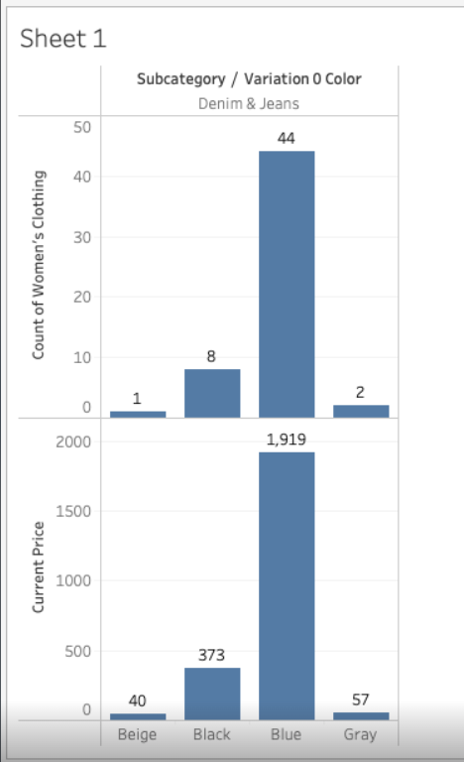
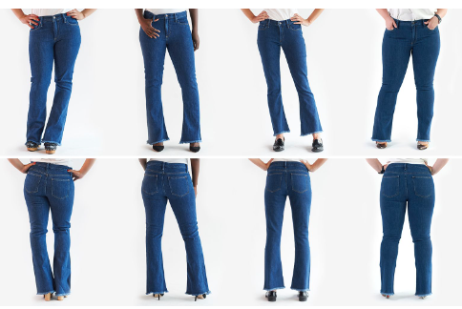
Current Price and Color in Jeans

Slide 22
Summary
For our team’s final project, we settled on a data set of women's clothing. As with any data set, it requires formation and modifications which we explored in 3 different types of programs. We settled on using Tableau, which is great for visual representation because most of our data set was categorical. We explored how brands, colors, prices, and clothing categories fluctuate depending on certain influencing factors. As may have been noticed, we mainly used bar charts, that being due to the data being mainly categorical. During our data exploration, we heavily strengthened our teamwork skills by learning how to help and work alongside each other in ways that benefit us long-term.

Slide 23
Reference Links
https://1drv.ms/p/s!AjUV9o4pn4l1kiIPvrTgy14zryfr?e=wzD3F0
https://github.com/Honeybun11516/Python-Final-Project-Data-Exploration
https://woz-u.slack.com/files/U03464CQC5D/F04DJ1U3LJC/untitled__2_.zip

